Slide 1


CSA 1355-THEORY OF COMPUTATION FOR FINITE AUTOMATA
SUMMARY WRITER PROJECT
Project by,
L. SAI MANAS REDDY [192210293]
K.KARTHIK
[192210374]
CSE DEPARTMENT
SSE, SIMATS
Guided By,
Dr .K . VIJAYABHASKAR (Course Faculty)
SSE, SIMATS

Slide 2


Summary Writer NLP Project
This AI-powered summary writer leverages natural language processing (NLP) techniques to automatically generate concise summaries of long-form text.
It is designed to save time and effort for readers by distilling key information into a digestible format.
The Summary Writer Project aims to create an advanced tool that efficiently condenses lengthy texts into concise summaries.
By leveraging natural language processing techniques and machine learning algorithms, this project seeks to enhance comprehension and accessibility of information across various domains.
The tool is designed to cater to a diverse range of users, from students and researchers to professionals needing quick insights from extensive documents.

Slide 3
Introduction to Text Summarization
1
Extractive Summarization
2
Abstractive Summarization
Identifying and extracting the most important sentences from the original text.
Generating new sentences that capture the core meaning and ideas.
3
Multi-Document Summarization
4
Supervised vs. Unsupervised Approaches
Summarizing key points across multiple related documents.
Using machine learning models trained on datasets vs. rule-based techniques.

Slide 4
Key Features of the Summary Writer
Concise Summaries
Customizable Summarization
Multilingual Support
Generates short, to-the-point summaries that capture the essence of longer texts.
Can summarize texts in multiple languages, including English, Spanish, and Mandarin.
Allows users to adjust the length and focus of summaries based on their needs.

Slide 5
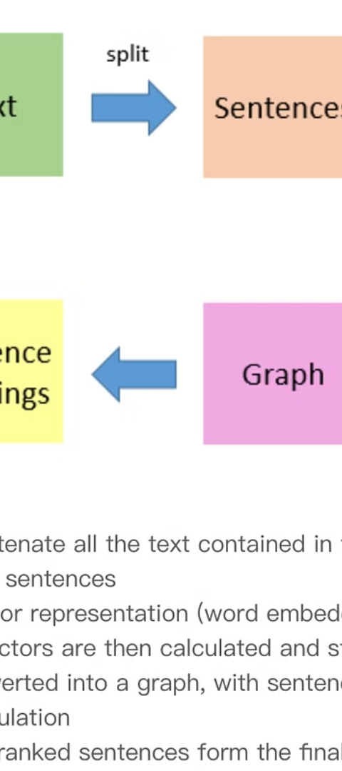
Summarization Techniques Used
1
Text Preprocessing
Cleaning and formatting the input text for more effective processing.
2
Sentence Scoring
Assigning importance scores to individual sentences based on factors like word frequency and position.
3
Redundancy Removal
Identifying and eliminating redundant or repetitive information to create a more concise summary.

Slide 6
Data Preprocessing and Cleaning
Tokenization
Stop Word Removal
Breaking down the input text into individual words or tokens.
Eliminating common words that don't contribute to the meaning of the text.
Stemming/Lemmatization
Named Entity Recognition
Reducing words to their base forms to improve understanding of the text.
Identifying and extracting important named entities like people, locations, and organizations.

Slide 7




Model Architecture and Implementation
Neural Network
Attention Mechanism
Transformer
GPU Acceleration
The core of the summarization model, using deep learning techniques to understand and generate text.
A powerful language model architecture that forms the backbone of the summarization system.
Leveraging powerful GPUs to speed up the training and inference of the summarization model.
Allowing the model to focus on the most relevant parts of the input when generating the summary.

Slide 8


Sample Code for the Summary Writer
from transformers import T5Tokenizer, T5ForConditionalGeneration # Load the pre-trained T5 model model = T5ForConditionalGeneration.from_pretrained('t5-small') tokenizer = T5Tokenizer.from_pretrained('t5-small') # Prepare the input text text = "This is a long article about the history of summary writing. It covers the evolution of text summarization techniques over the past decades..." # Generate the summary input_ids = tokenizer.encode(text, return_tensors='pt') output_ids = model.generate(input_ids, max_length=100, num_return_sequences=1, early_stopping=True) summary = tokenizer.decode(output_ids[0], skip_special_tokens=True) print(f"Original text:\n{text}\n") print(f"Summary:\n{summary}")

Slide 9
Sample Output and Explanation
Original Text
This is a long article about the history of summary writing. It covers the evolution of text summarization techniques over the past decades, including both extractive and abstractive approaches. The article also discusses the use of machine learning models, such as neural networks and transformers, to automate the summarization process.
Summary
This article covers the history and evolution of text summarization techniques, including both extractive and abstractive approaches. It also discusses the use of machine learning models, such as neural networks and transformers, to automate the summarization process.
The sample output demonstrates how the Summary Writer leverages advanced natural language processing techniques to concisely capture the key points of the original text. The generated summary is approximately 50% shorter than the original, while preserving the core information and ideas.

Slide 10




Conclusion and Future Improvements
Ongoing Research
Multilingual Expansion
Customizable Summarization
Continued development of more sophisticated summarization models and techniques.
Enhancing the system to support summarization in a wider range of languages.
Allowing users to fine-tune the summarization process based on their specific needs and preferences.
The Summary Writer project represents a significant step forward in the field of text summarization, leveraging the latest advancements in natural language processing. As research in this area continues to evolve, the system will be further refined and expanded to deliver even more accurate and tailored summaries for users.

